Slide 1
Circuit inquiry: Open Collector Logic
By Ian Sbar
For RBT125

Slide 2
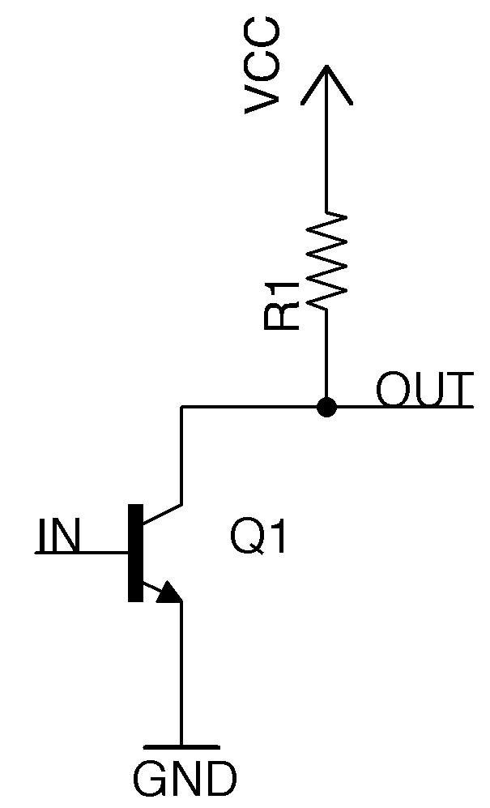
What does this circuit do?
An open-collector Logic gate is a type of digital circuit that has technically more than 2 outputs and uses a bipolar junction transistor. When disconnected from power, the signal is pulled low, which technically gives the circuit 2 outputs, which are 0 volts, or floating. When connected to power thanks to a pull up resistor that pulls the signal high, the output is the same as the power supply, or VCC on the diagram (Making Stuff with Chirs DeHut, 2023).

Slide 3
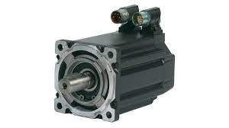
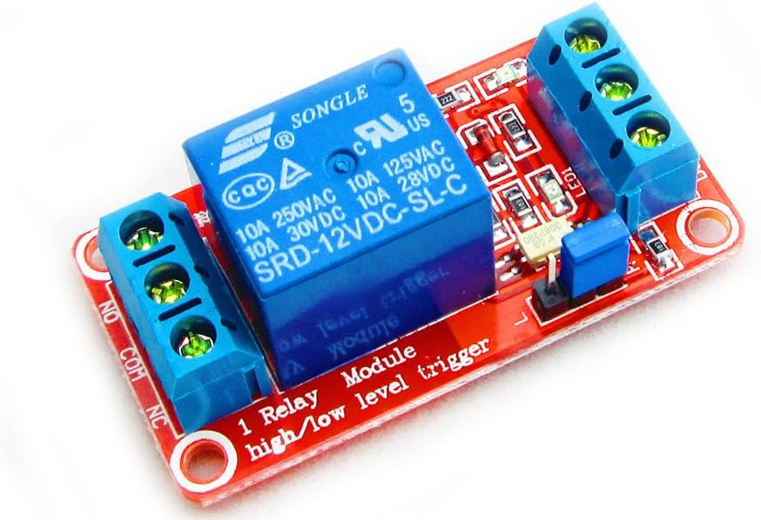
Where is this circuit used?
Because Open collector logic circuits use a pull up resistor, it is possible to send different voltage signals, which makes open collectors excellent for controlling other parts found in electric circuits, such as “… powering a 12-volt relay or interfacing with devices that require varying input voltage levels, like digital logic gates, amplifiers, sensors, servo motors and logarithmic converters” (Shelzer, 2020). In a way, Open collector logic can kind of be used as a very basic form of analog output.

Slide 4
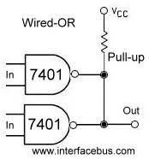
Advantages
The open collector logic circuit's ability to have an output connect to more than one line allows the creation of a wired OR connection between more than 1 output (Open-collector logic, 2022).
Open collector logic circuits are great for driving low current electronics since they sink much less current than your usual output devices (Open-collector logic, 2022).
The power that is connected to the pull-up resistor is external. This means open collector logic circuits don’t generate much electrical interface (Open-collector logic, 2022).

Slide 5
Disadvantages
As with any circuit that can have an output connect to more than one line, an open collector output can suffer from contention. For open collector logic circuits, this can happen when two or more of the devices connected to the output try to pull the output low at the same time (Open-collector logic, 2022). Another disadvantage is the fact that Open-collector logic circuits require a separate power source for the pull-up resistor.

Slide 6
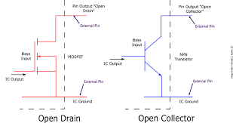
Variations
Open Drain
Open-drain circuits perform the exact same function as an open collector circuit. The difference between them is that an open-drain circuit uses a MOSFET instead of a Bipolar junction transistor. Because these circuits use MOSFETs, they are more power efficient and more heat resistant. Additionally, they also have much higher input impedance, making them great in power amplifiers. However, they these circuits can not switch as fast as open collector circuits (Bleything, 2023).

Slide 7
References
Shelzer, R. (2020, August 18). Understanding open collector relays. Global Electronic Services. https://gesrepair.com/open-collector-relay/#:~:text=Why%20Are%20Open%20Collectors%20Used,want%20to%20activate%2C%20without%20interference.
manikanta2017. (2022, November 9). Open-collector logic. GeeksforGeeks. https://www.geeksforgeeks.org/open-collector-logic/
Making Stuff with Chirs DeHut. (2023, June 29). How to work with Open Collector outputs [Video]. Youtube. https://www.youtube.com/watch?v=7zGw70Pbggw
Bleything, T. (2023, April 17). Open collector vs. open drain. Digilent Blog. https://digilent.com/blog/open-collector-vs-open-drain/

